Slide 1
Image blending
Annie Dai, Xinbei Fu
CS 189 Final Project

Slide 2
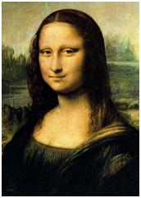
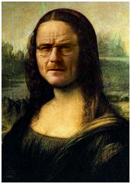


Motivation
+
=

Slide 3
Laplacian pyramid blending

Slide 4
http://sepwww.stanford.edu/data/media/public/sep/morgan/texturematch/paper_html/node3.html
Laplacian pyramid blending
Last level = gaussian last level
Laplacian level i = gaussian level i – expand(gaussian level i+1)
Notes:
Some theory here

Slide 5
Laplacian pyramid blending
General approach :
Build Laplacian pyramids LA and LB from images A and B
Build a Gaussian pyramid GR from selected region R
Form a combined pyramid LS from LA and LB using nodes of GR as weights:
LS(i, j) = GR(i, j) * LA(i, j) + (1 – GR(i, j)) * LB(i, j)
Collapse the LS pyramid to get the final balanced image
Notes:
Show some result images here

Slide 6
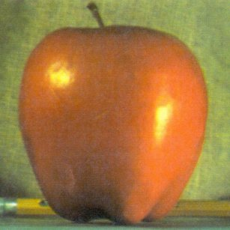
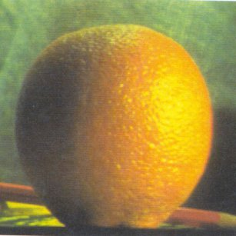
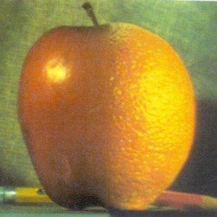
Laplacian pyramid blending
+
=
Notes:
Show some result images here
Change to our own image

Slide 7

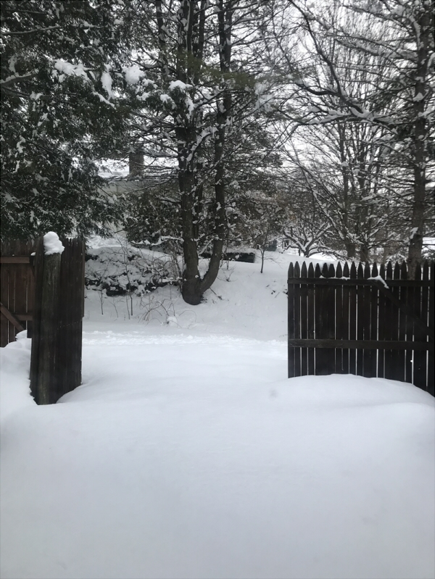
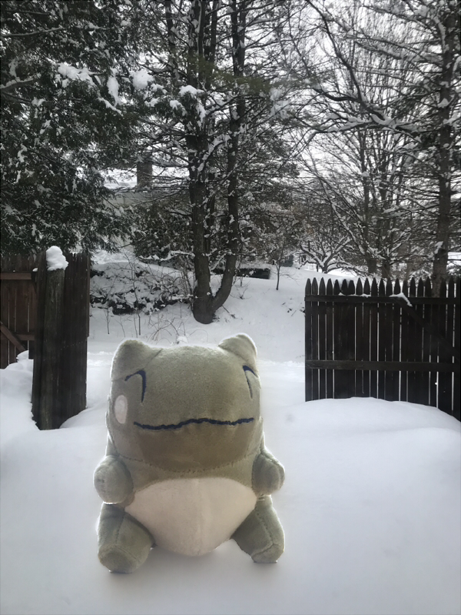
Laplacian pyramid blending
+
=
Notes:
Show some result images here
Change to our own image

Slide 8
Poisson blending

Slide 9
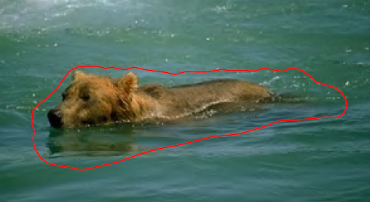
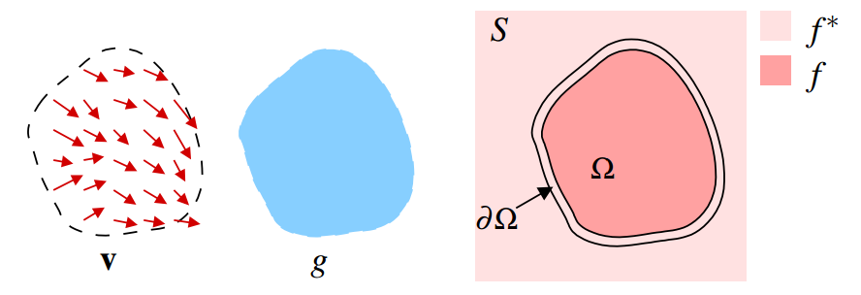
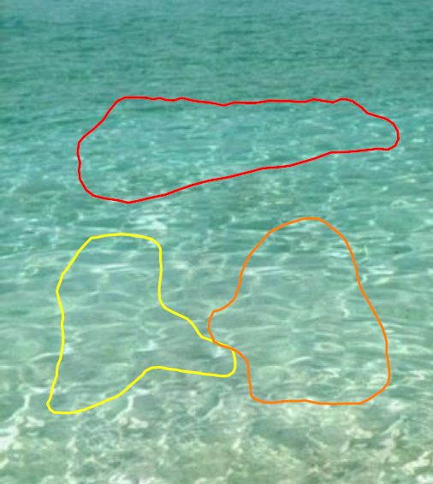
Poisson blending
v – Gradient of a region in an image
g – Selected region of source
f* – Known functions that exist in domain S
f – Unknown functions that exist in domain Ω
Ω – Region g that is now placed on domain S
∂Ω – Boundaries between the source and target regions
[Patrick et al. 03]
Notes:
theory

Slide 10





Poisson blending
, with
, for all
Solution:
$$A$$
$$∗$$
$$f$$
$$=$$
$$b$$
Gradient
operator
Blended
source
Source gradient
with
Boundary condition

Slide 11
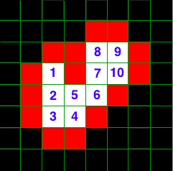
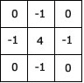


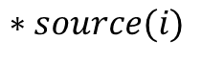
Poisson blending
 | 1 | 2 | 3 | 4 | 5 | 6 | 7 | 8 | 9 | 10
1 | 4 | -1
2 | -1 | 4 | -1 |  | -1
3 |  | -1 | 4 | -1
4 |  |  | -1 | 4 | -1
5 |  | -1 |  | -1 | 4 | -1
6 |  |  |  |  | -1 | 4 | -1
7 |  |  |  |  |  | -1 | 4 | -1 |  | -1
8 |  |  |  |  |  |  | -1 | 4 | -1
9 |  |  |  |  |  |  |  | -1 | 4 | -1
10 |  |  |  |  |  |  | -1 |  | -1 | 4
$$A$$
$$b\left[i\right]=div\left(source\left(i\right)\right)+NeighborOnBoundary\left(target(i)\right)$$
$$b$$
$$∗source(i)$$
http://eric-yuan.me/poisson-blending/

Slide 12
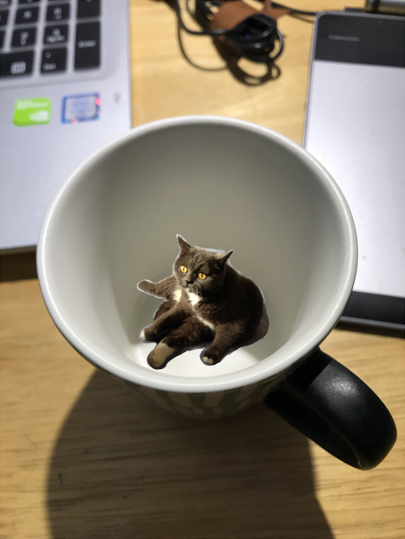
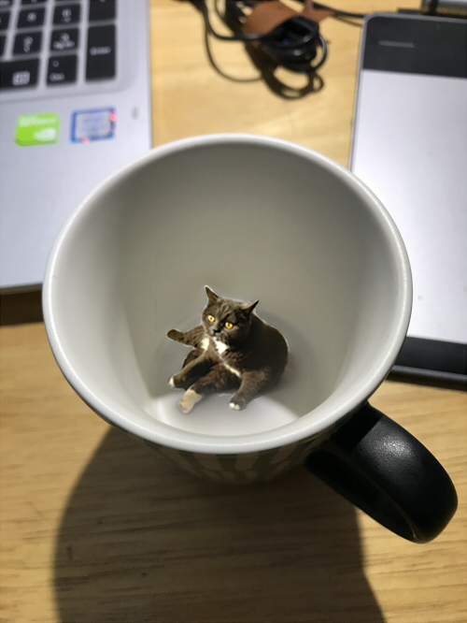
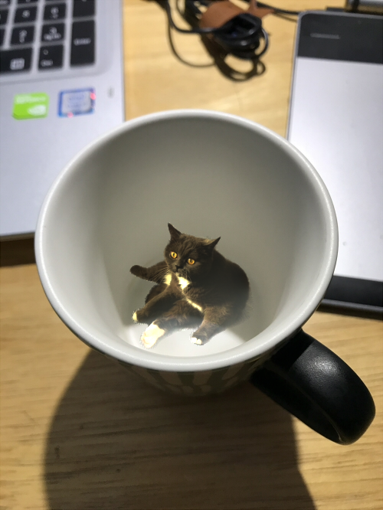
Poisson blending
Cut and paste
Laplacian blending
Poisson blending
Notes:
show some results

Slide 13
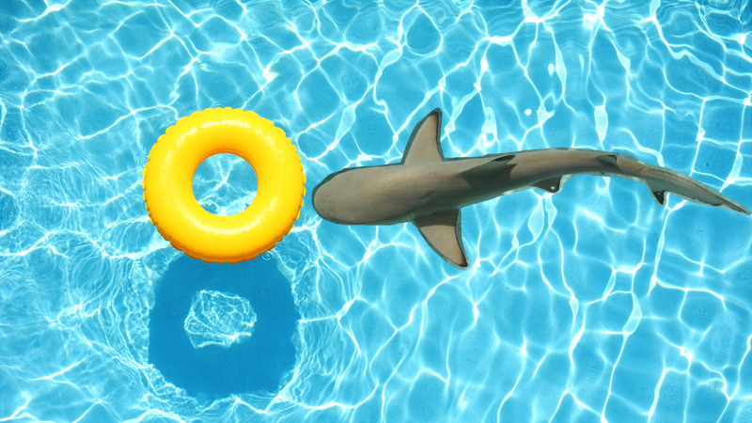
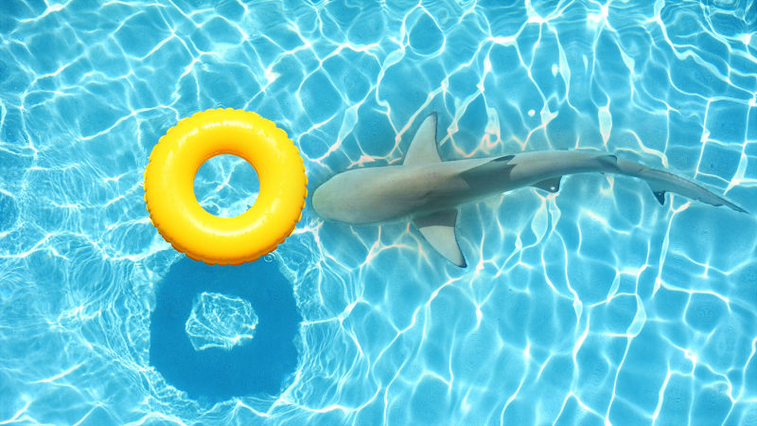
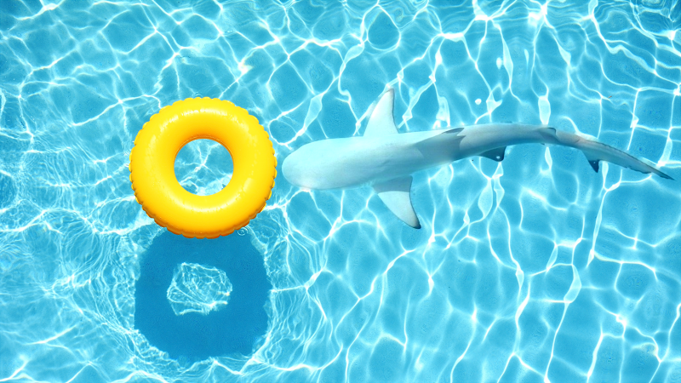
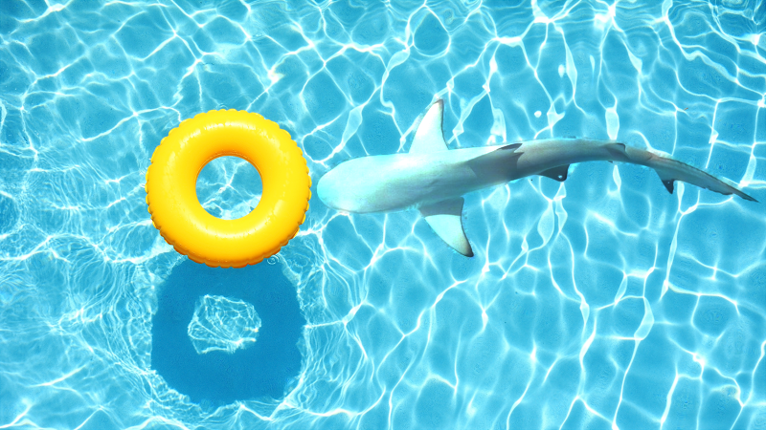
Poisson blending : take logarithm
Cut and paste
Laplacian blending
Poisson blending
Poisson blending in log domain
Notes:
show some results

Slide 14
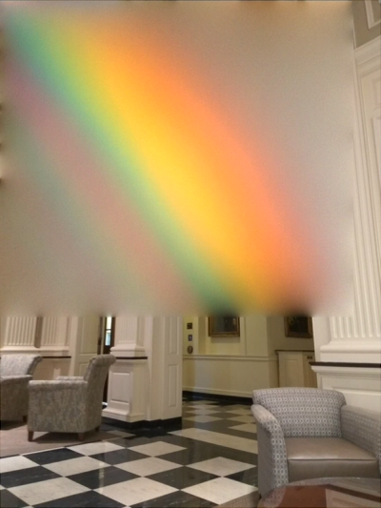
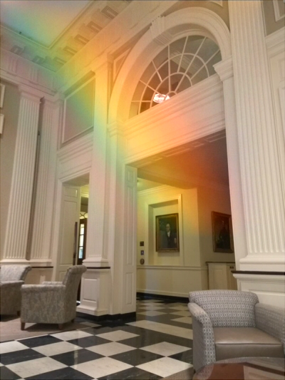
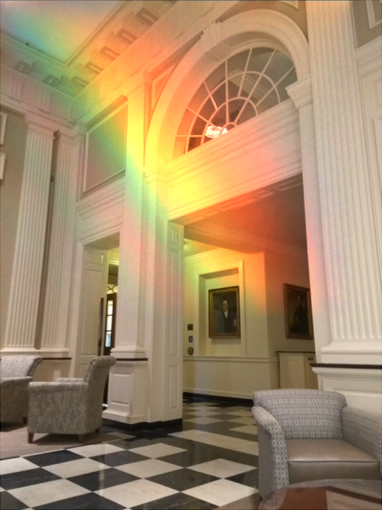
Poisson blending : mixture gradient
Poisson blending
Mixture gradient
Mixture gradient in log domain

Slide 15
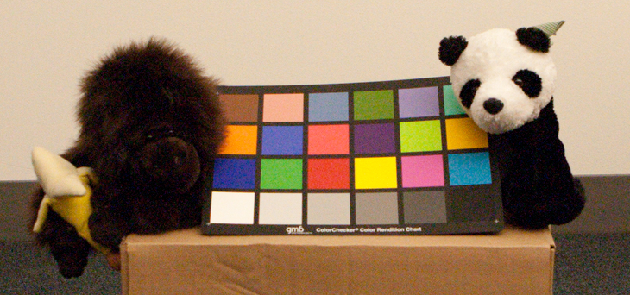
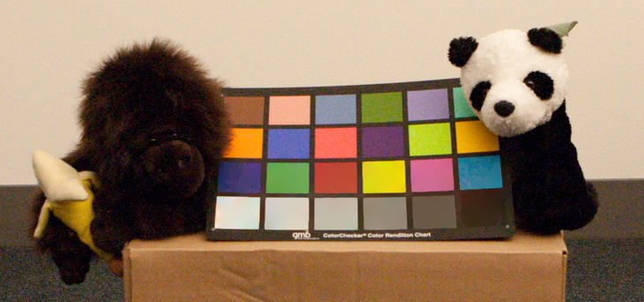
Poisson blending : texture flattening
Original image
Texture flattened image
Texture got flattened

Slide 16
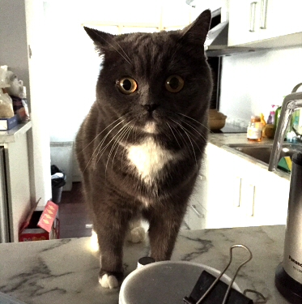
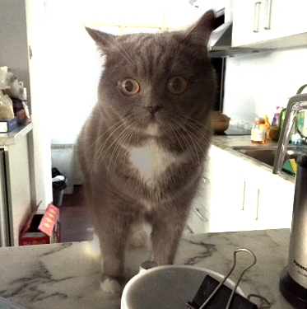
Poisson blending : local illumination change
Original image
Cat’s illumination changed

Slide 17
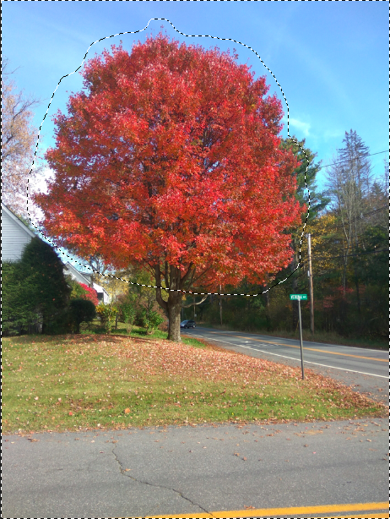
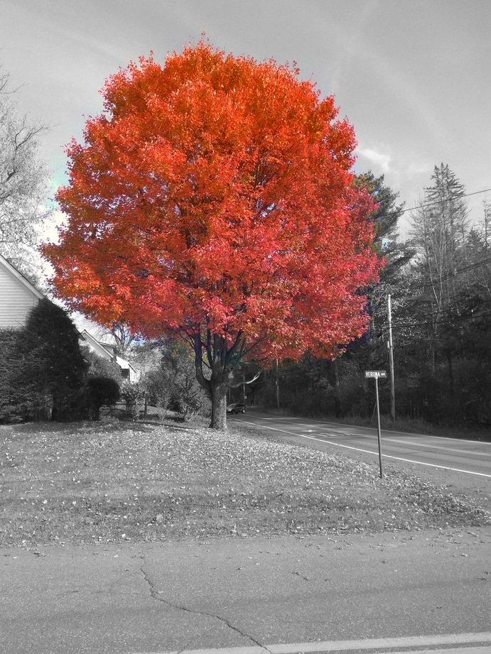
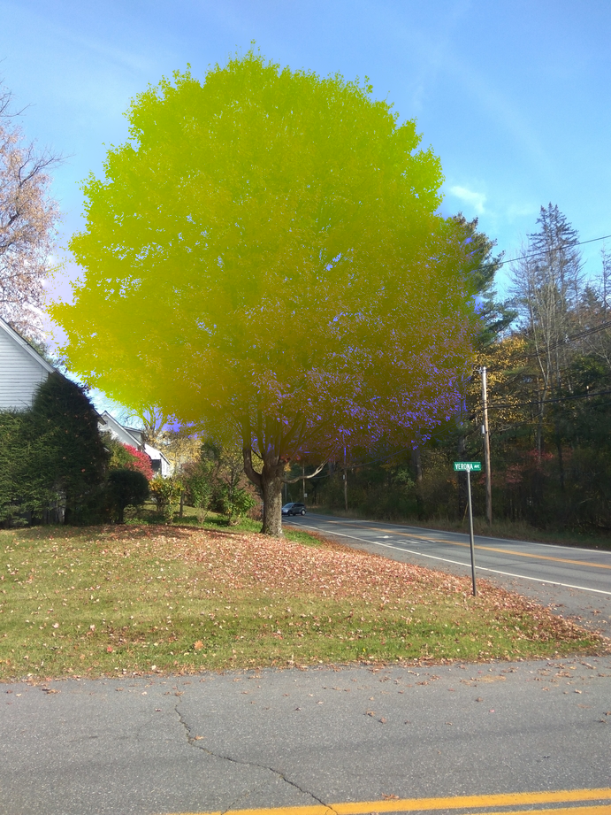
Poisson blending : local color change
Original image
Selected region decolorized
Selected region color changed

Slide 18

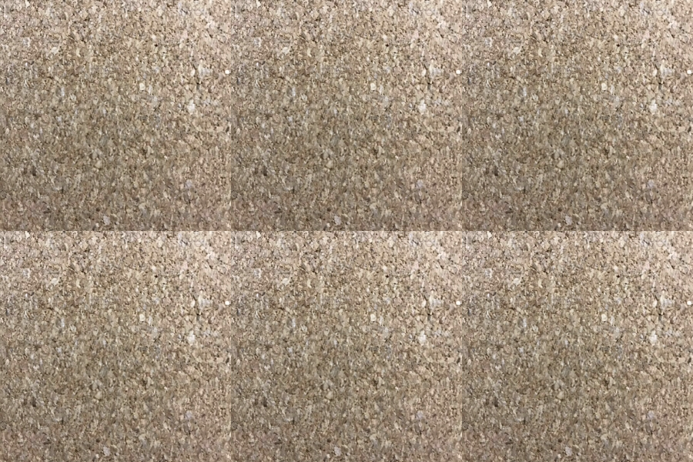


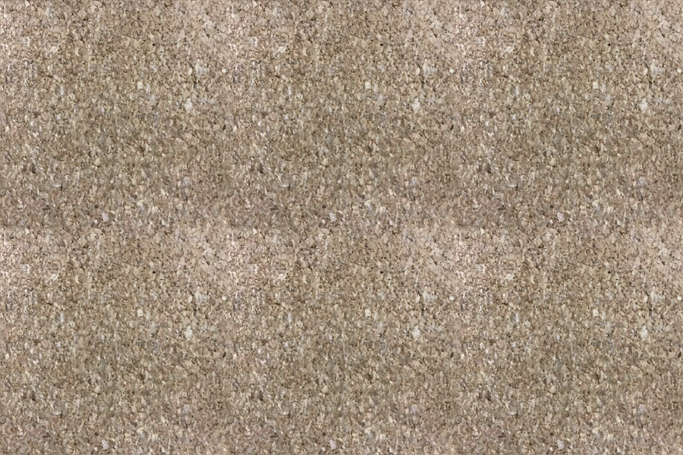

Poisson blending : seamless tiling
Naïve tiling
Seamless tiling

Slide 19
reference
Patrick Pérez, Michel Gangnet, and Andrew Blake. 2003. Poisson image editing. In ACM SIGGRAPH 2003 Papers (SIGGRAPH '03). ACM, New York, NY, USA, 313-318. DOI: https://doi.org/10.1145/1201775.882269
http://sepwww.stanford.edu/data/media/public/sep/morgan/texturematch/paper_html/node3.html
http://eric-yuan.me/poisson-blending/
Raanan Fattal, Dani Lischinski, and Michael Werman. 2002. Gradient domain high dynamic range compression. In Proceedings of the 29th annual conference on Computer graphics and interactive techniques (SIGGRAPH '02). ACM, New York, NY, USA, 249-256. DOI=http://dx.doi.org/10.1145/566570.566573
http://graphics.cs.cmu.edu/courses/15-463/2005_fall/www/Lectures/Pyramids.pdf
http://cs.haifa.ac.il/hagit/courses/ip/Lectures/Ip11_MultiscaleRepx4.pdf

